Slide 1
Will a flight ruin my honeymoon?
Aída Moure Fernández
Final Project
IronHack PT JAN24
July 10th 2024

Slide 2





Slide 3
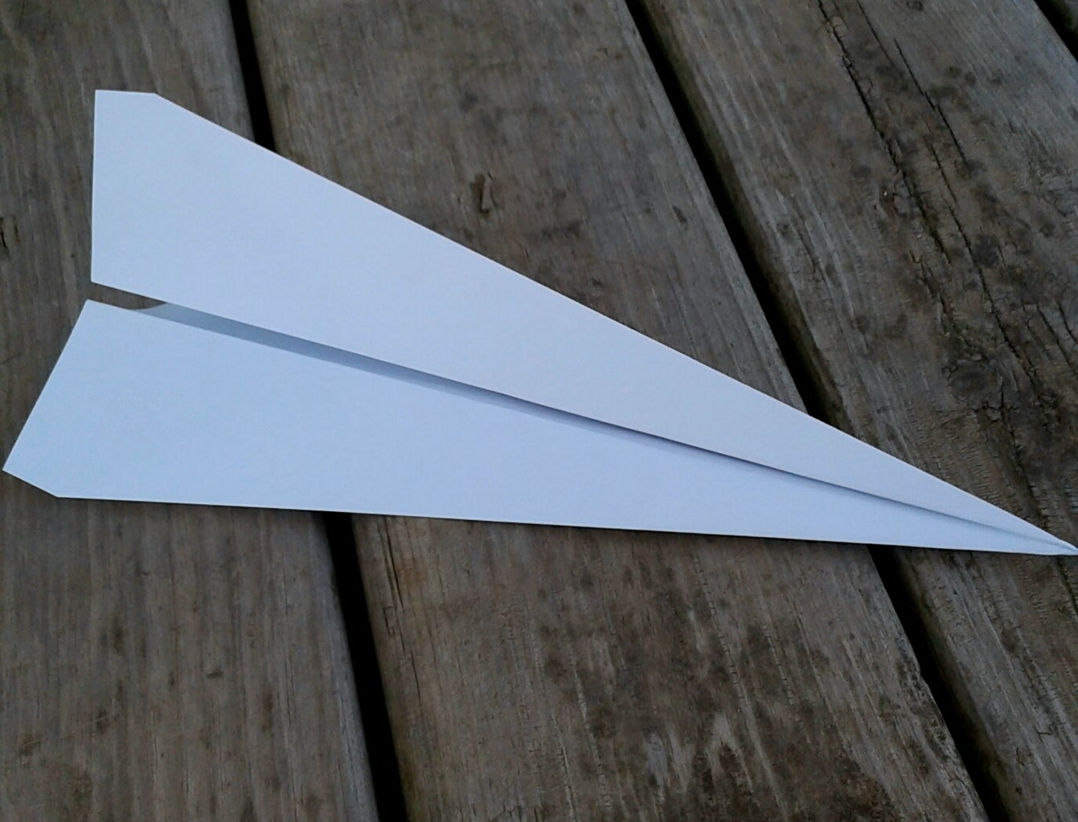

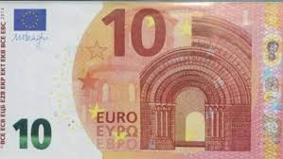
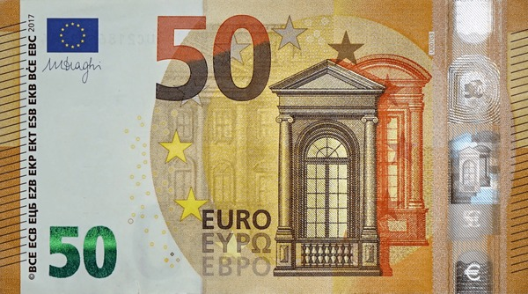


Slide 4
Index
Objective and Data Sources
Exploratory Data Analysis
Descriptive Statistics
Models
What factors make an impact in a (positive) recommendation?
Logit/KNN classification models accounting for imbalance and multicollinearity
What factors make an impact in a (high) overall score?
OLS/KNN regression models
Random forest + feature importance
Real Traveler Reviews and word cloud
Sentiment analysis
Review Prediction
LSTM models
Airline Classifier
Random Forest Regressor
Airline Recommender
Nearest Neighbors

Slide 5
What is this ALL about?
Objective: analysis of real airlines based on reviews & other data provided by previous customers
Data Source: ‘128k Airline Reviews’ (https://www.kaggle.com/datasets/joelljungstrom/128k-airline-reviews).
Initial Dataset: 129,454 rows & 22 columns:
Aircraft
Airline
Cabin Type (Economy, Premium Economy, Business, First Class)
Dates (trip, publication)
Ratings (Entertainment, Cabin service, Ground service, Food, Wi-Fi, Seat comfort, Value for money)
Geographic variables: Origin Country, Route
Overall Score: Total score (0-10) of the trip
Recommended
Review (title, body)
Travel Type (Solo, Couple, Family + Business, Leisure)
Trip Verification

Slide 6
eda
Data Exploration: describe, check missingness %, value counts.
Data Cleaning: renaming, replacing unclear values, drop duplicated values,
dropping negative dates.
Treatment of missingness:
> 3% : not use the var or drop missing values
< 3% : impute (mean, mode)
Feature engineering:
Travel Type → traveller (solo, couple, family) & purpose (leisure, business)
Route → origin/destiny/scale (yes/no)
Entertainment Rating→ if entertainment rating>0, flight = Long Distance
Origin Country → Continent
Trip Date→ Year
Categoricals: string to numeric

Slide 7

Descriptive statistics
Many Airlines, few observations:
airlines 2k+ reviews
6 airlines
(out of 547)
Clean DB: 90,008 rows & 27 columns
American Airlines ~ 5k
Spirit Airlines ~ 4k
United Airlines ~ 3.7k
Delta Airlines ~ 2.3k
British Airways ~ 2.7k
Frontier Airlines~ 2.7k

Slide 8
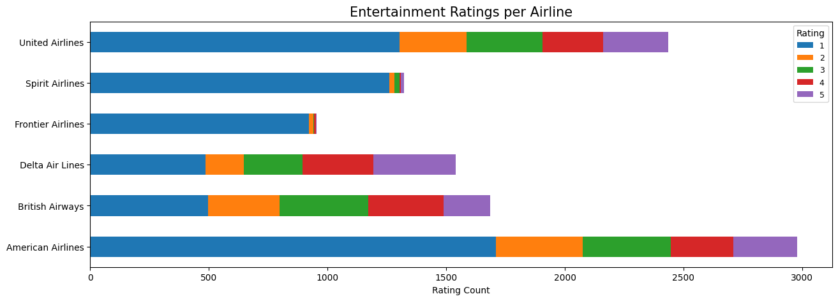
Ratings eNTERTAINMENT
* Only for long-distance values
Only for Long-Distance flights
Most Airlines fail to entertain properly
Spirit and Frontier are the less valued

Slide 9
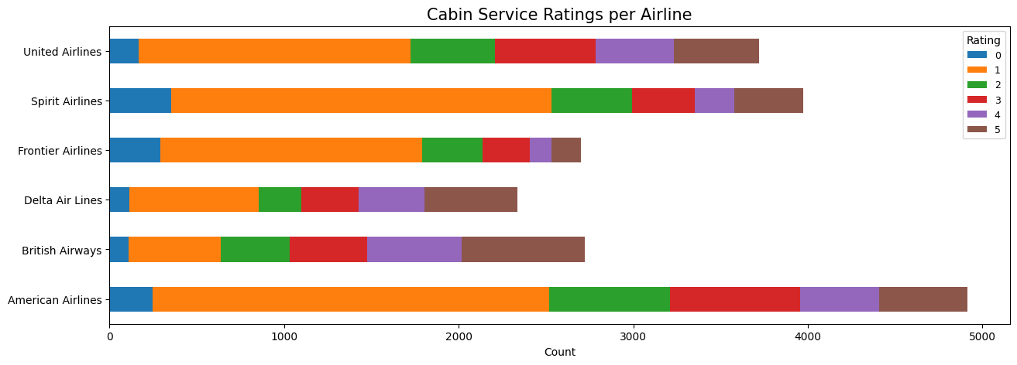
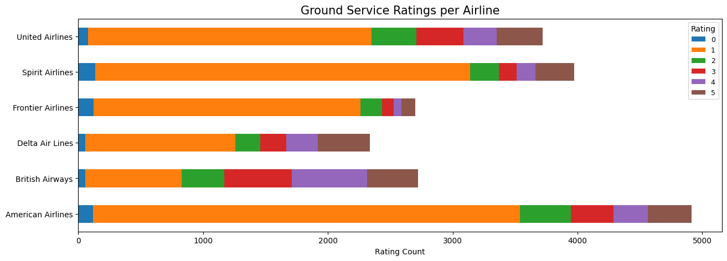
Ratings Staff services
Most Airlines have a poor staff service
Ground service is worse than Cabin Service in all Airlines
British Airways is the best valued while American, United & Spirit are the less valued

Slide 10
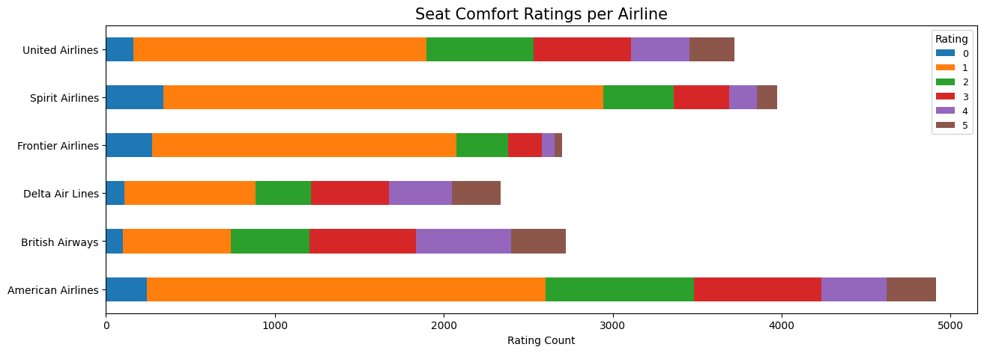
Ratings food
No Airline is considered to have comfortable seats.
American Airlines and British Airways stand as the most valued. Frontier is the most penalized.

Slide 11
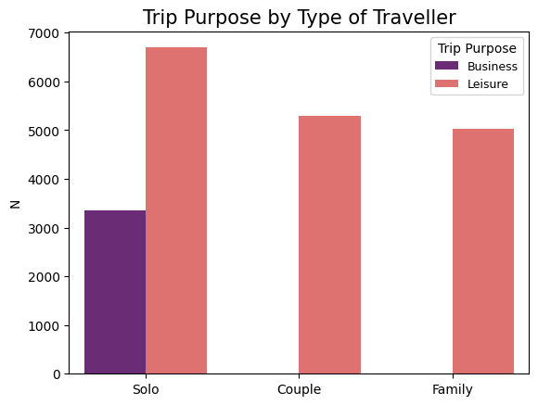
Type of travEler by Trip purpose
People in business trips travel alone
Travelling with couple/family is always for leisure
Most travelers overall travel alone

Slide 12
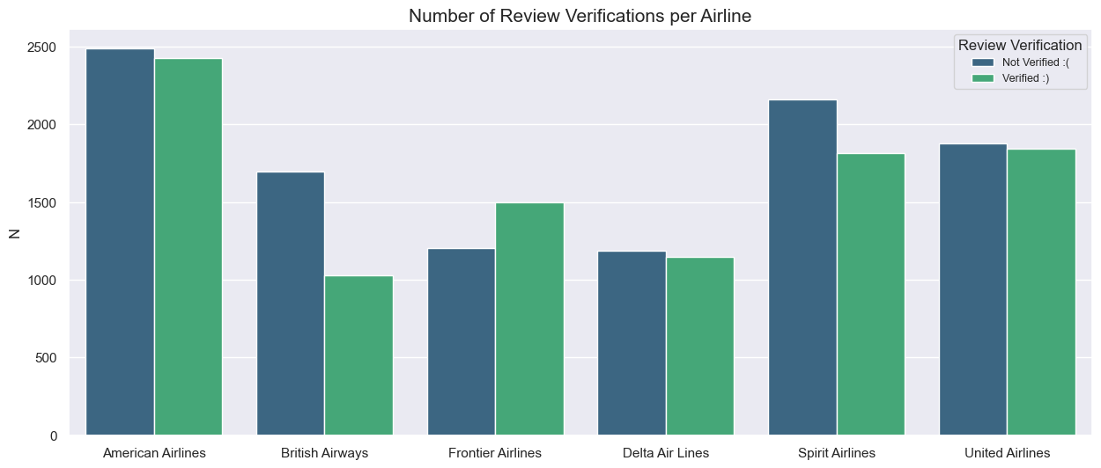
verifications per airline
Except Frontier Airlines, most companies have unverified trips
Can we trust British Airways data?

Slide 13
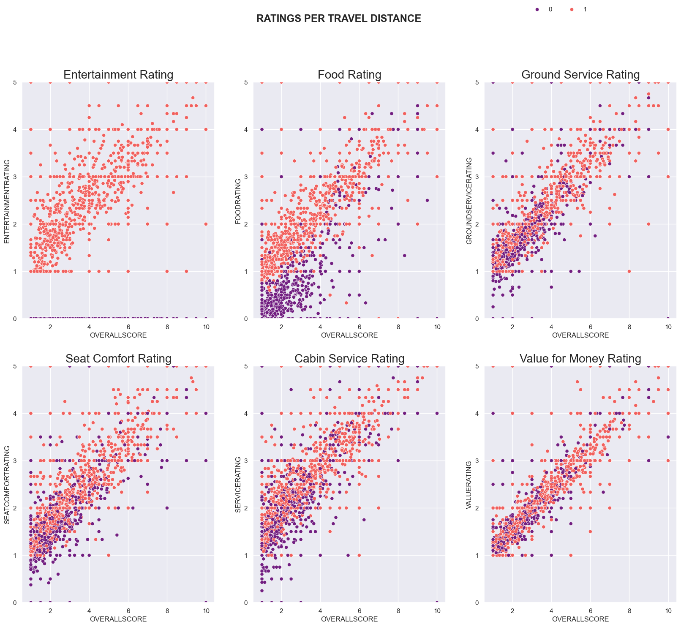
Analysis PER TRAVEL DISTANCE Ratings & overall score
Food is more valued in long-distance flights
Staff Services are slightly better in long-distance flights. Same with seat comfort
There is no entertainment rating in short-distances
No significant differences in value for money according to distance

Slide 14
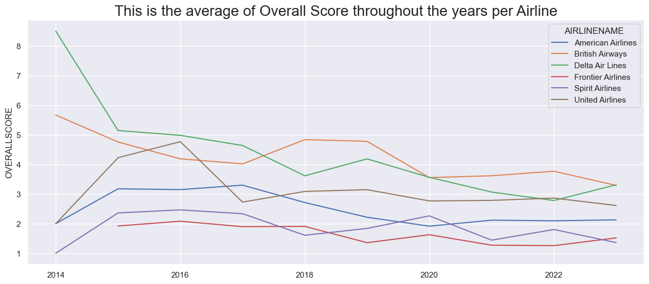
OVERALL SCORE THROUGH TIME
PER AIRLINE
General decreasing trend
Frontier is considered the worst airline
British Airways is considered the best airline
Delta satisfaction fell 50%

Slide 15
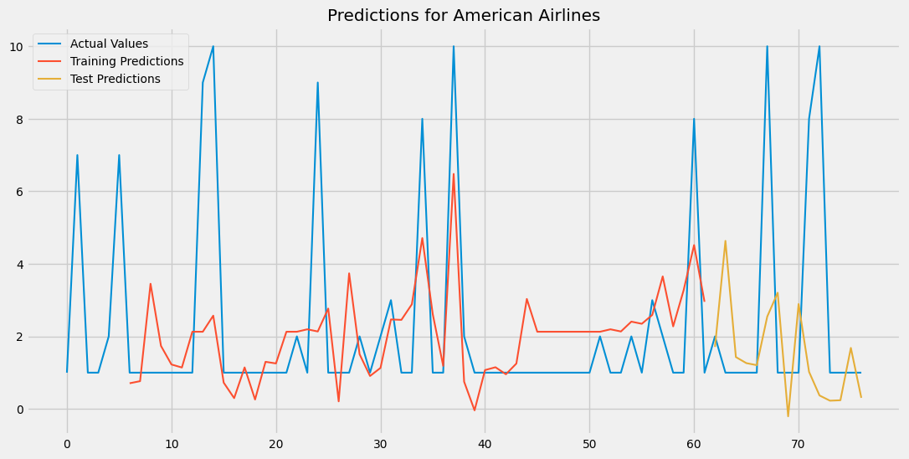
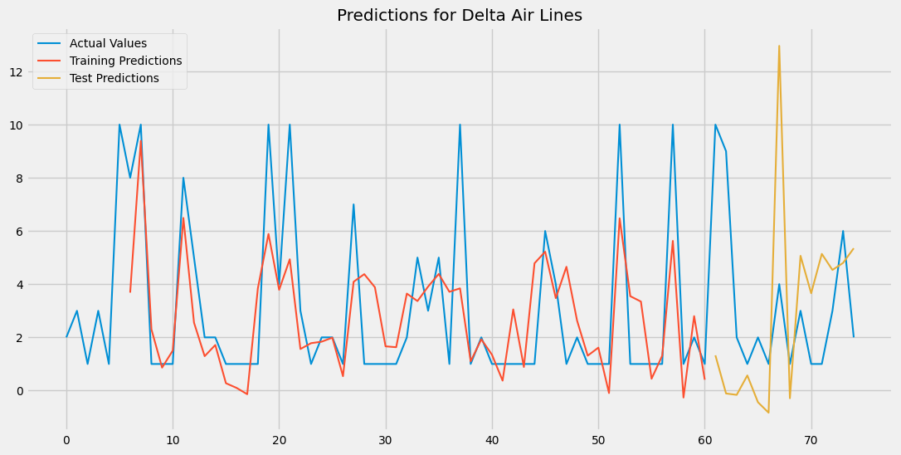
Review prediction How will overall score behave in future reviews?
Slightly worse prediction (beyond thresholds)
Tendency to increase
Slightly better prediction
Tendency to decrease
Methodology: LSTM

Slide 16
What does influence
a flight to be recommended?

Slide 17
What does influence a flight to be recommended?
Models type: classification
Model 1: Logistic Regression (Logit)
Dependent variable: ‘recommended’
Independent variables: cabin, traveler, purpose, ratings, long distance, verified, scale, year
Assumptions:
Check for multicollinearity:
Crosstab (Strongly correlated except ‘purpose’)
Correlation matrix, VIF ok when dropping all ratings except ‘Cabin Service’ and ‘year’
Model correlated but not overfitted
Unbalancing considered in dependent variable

Slide 18
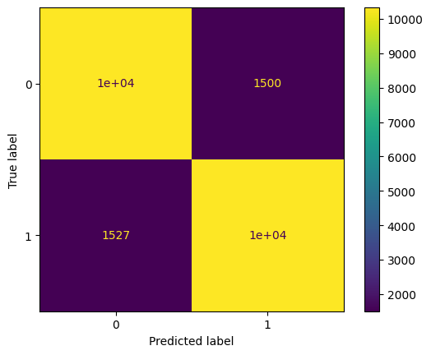
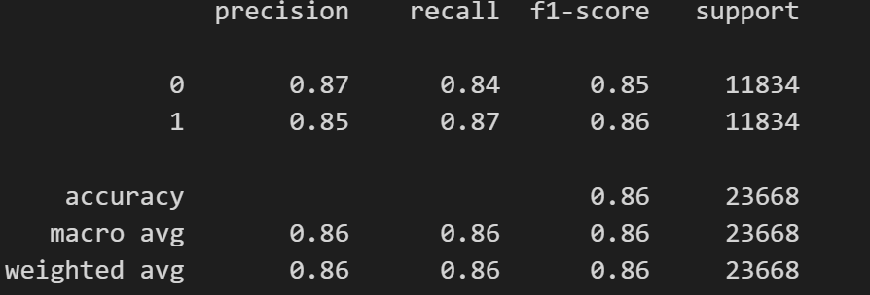
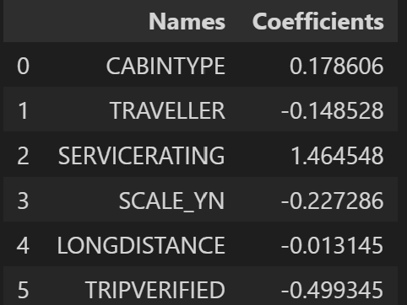
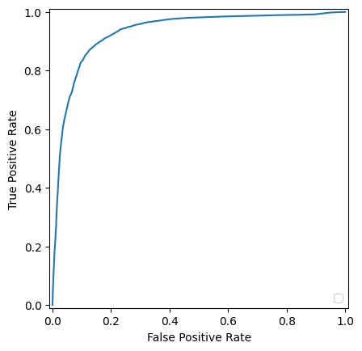
What does influence a flight to be recommended?
Logit results
Economy vs. Luxury
Cabin Service Rating
Family vs Solo
Scale
Long Distance
Trip Verification
Notes:
Cambiar tablas!

Slide 19

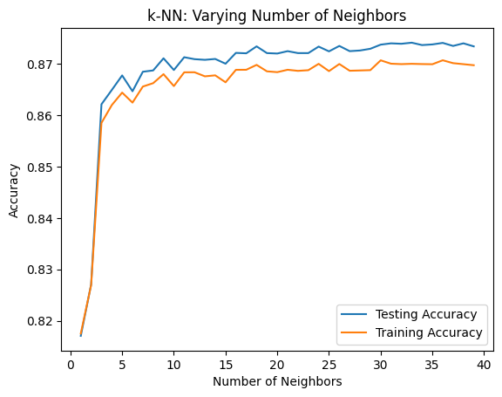
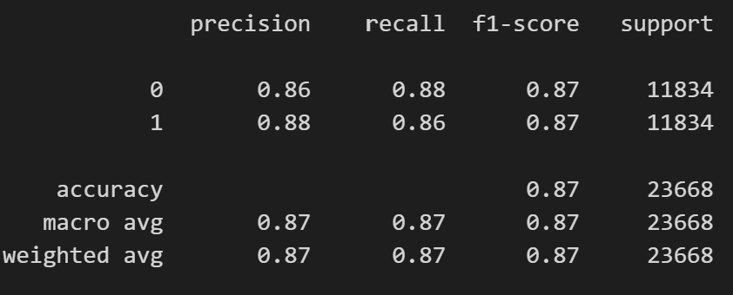
Model 2: K-Nearest Neighbors (KNN)
HP tuning: 'n_neighbors': 36, 'weights': 'distance'
Advantages over Logit:
Avoids multicollinearity issue
Model accuracy slightly better

Slide 20
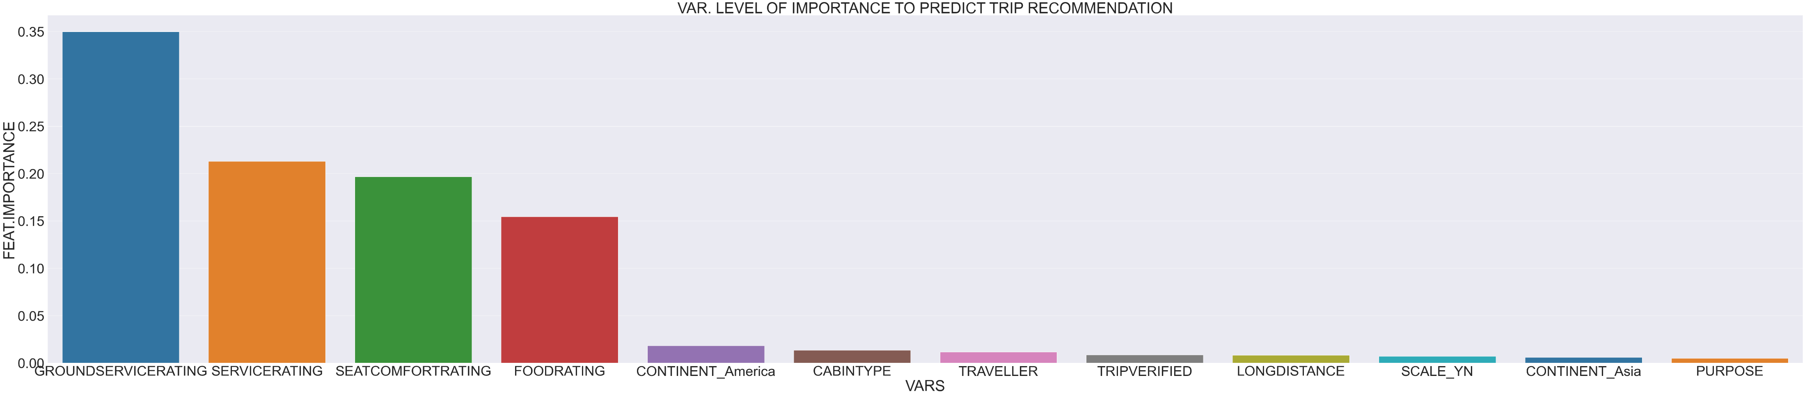
Model 3: Random Forest Classifier
Dependent variable: ‘recommended’
Independent variables: cabin, traveler, purpose, ratings, verification, scale, long distance, continent
HP Tuning: max_features': 'sqrt', 'min_samples_leaf': 2, 'min_samples_split': 2, 'n_estimators’: 150
Goodness of fit: 0.93

Slide 21
CLASSIFICATION MODEL RESULTS
Ratings are the variables that most affect a positive recommendation
Most expensive cabin type and Service rating influence the recommendation positively
Scales, travelling in couple/family, Long Distance trips and Trip Verification affect negatively the recommendation
All these variables explain approximately 85-90% of the result
Correlation is present in the data, so better to use KNN or random forest models

Slide 22
What does influence the overall score of a flight?

Slide 23
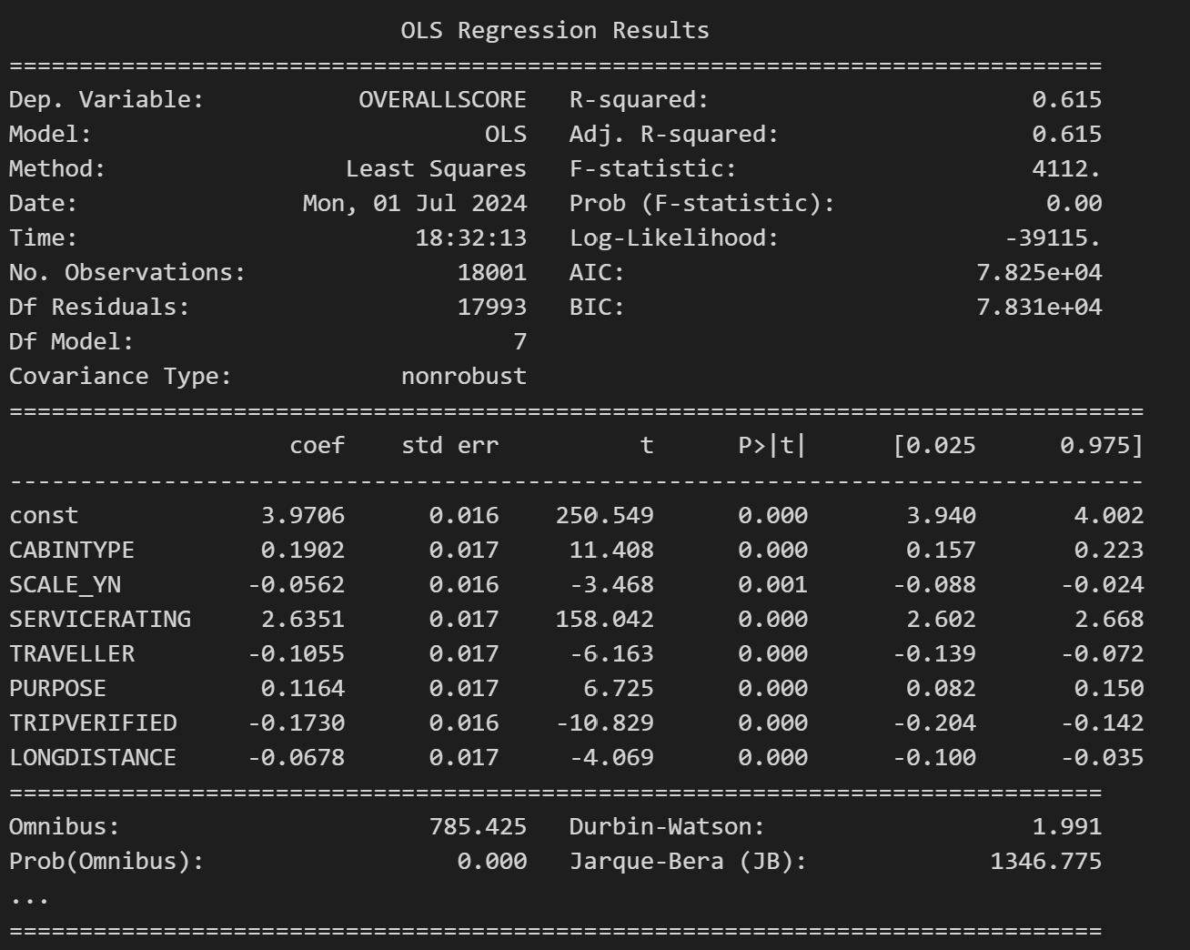
What does influence the overall score of a flight?
Models type: regression
Model 1: Ordinary Least Squares (OLS regressor)
Dependent variables: ‘Overall Score’
Independent variables: Type of Cabin, Cabin Service Rating, Type of Traveller, Purpose, Verification, Long Distance, Scale
Strong correlation →drop time variable and all ratings except cabin service
Goodness of fit: 0.62, all significant variables

Slide 24
What does influence the overall score of a flight? Knn REGRESSION MODELS
Model 2: KNN regressor
Assumption: avoids multicollinearity issues
HP Tuning: 'algorithm': 'auto', 'n_neighbors’: 60, 'weights’: distance’
Goodness of fit: 0.66
Model 3: KNN regressor including more ratings
Assumption: KNN avoids multicollinearity issues → Add some other ratings (food, ground service, seat comfort)
HP Tuning: 'algorithm': 'auto', 'n_neighbors’: 45, 'weights’: uniform’
Goodness of fit : 0.85

Slide 25
REGRESSION MODELS RESULTS
Type of cabin, cabin service and trip purpose influde positively in overall score
Scale, type of travel, verification and long distance influence negatively overall score
KNN model avoids multicollinearity and allows for more ratings to be included → more robust and explains overall score better

Slide 26
Other models
Classifier System. User rates each item and obtains an overall score + other 5 airlines with same score.
Model: random forest regressor
HP Tuning: max_depth': 10, 'max_features': 'sqrt', 'min_samples_leaf': 1, 'min_samples_split': 5, 'n_estimators': 300
R2 = 0.9
Recommender System. User enters an airline and obtains a recommendation of similar options. (Not limited to 6 main airlines)
Model: Nearest Neighbors
Parameters: n_neighbors=6, algorithm='ball_tree’
Both models based on ‘rating’ and overall score variables

Slide 27

Other models
Classifier System. Sentiment Analysis.
Title vs. Review
Tokenized and lemmatized titles
Personalized stop words (avoid neutrality)
Sentiment based on negative (-1), neutral (0) and positive (+1) titles
Double filter with overalls core: positive (7+), and negative (up to 3)
Word Cloud. Sentiment analysis into figures

Slide 28
Airline recommender app: the flight judge
https://flight-judge.streamlit.app/

Slide 29
JUST TO WRAP IT UP
Price and timelines are important when choosing a flight…but never underestimate other surrounding factors!
Ratings matter when recommending or scoring a flight. But so do other inputs such as how and with whom we travel.
Most airlines seem to be poorly rated, specially in economy class. Satisfaction tends to decrease with time (flights cheapen).
Honeymoon flights == patience! Sun and adventures will worth it ☺

